Slide 1

NANDHA ENGINEERING COLLEGE ERODE – 52 (AUTONOMOUS)
Department of Artificial Intelligence and Data Science
Deepfake Audio Detection Using Self-Supervised Speech Embeddings and LSTM/BiLSTM Network
Presented by :
ARAVINDHAN A(22AI002)
MADHAN V (22AI025)
PREM KUMAR R (22AI039)
Guided By : Ms. M. Parvathi, M.E., Ph.D. Assistant Professor, AI & DS
Team No: 02
22AID01- Project Work
Notes:
1

Slide 2
CONTENTS
Introduction
Problem Statement
Objectives
Moduls
Why These Models
Methodology
Algorithms Used
Notes:
2

Slide 3
CONTENTS
Mathematical Model Techniques Used
System Flow
Architectural Framework
Architecture Diagram
Existing System
Proposed System
Performance Metrics
Notes:
2

Slide 4
CONTENTS
Screenshot Advantages Applications Publications
References
Notes:
2

Slide 5
INTRODUCTION
Rapid growth of AI-based voice synthesis technologies.
Deepfake audio can closely mimic real human speech.
Difficult to distinguish fake audio manually.
Creates serious threats in digital communication.
Used in fraud,Scam, and misinformation attacks.
Reduces trust in media and communication systems.
Requires automated and intelligent detection methods.
Deep learning plays a key role in solving this problem.
Notes:
2

Slide 6
PROBLEM STATEMENT
Deepfake audio is highly realistic and difficult to distinguish from real speech.
Manual detection is unreliable and time-consuming.
Existing systems fail to detect unseen deepfake audio samples.
Rapid advancements increase risks of fraud, impersonation, and misinformation.
There is a need for accurate and real-time deepfake audio detection.
Notes:
2

Slide 7
OBJECTIVE
To detect whether audio is real or fake accurately
To improve model performance and detection accuracy
To build a system with low computational complexity
To enable real-time audio analysis and prediction
To use deep learning models for better feature learning
To provide a simple and interactive user interface
To enhance security in digital communication systems
Notes:
2

Slide 8
MODULE 1: AUDIO INPUT
Description: This module allows the user to upload an audio file through a web-based interface.The system supports multiple audio formats such as WAV, MP3, OGG, FLAC, and M4A.Once uploaded, the audio is read and converted into a numerical format suitable for further processing by the deep learning model..
Techniques Used:
Python
Streamlit (Web Interface)
Notes:
2

Slide 9
MODULE 2: AUDIO PRE-PROCESSING
Description: The uploaded audio is pre-processed to ensure uniformity and noise robustness.The audio signal is resampled to a fixed sampling rate (e.g., 16 kHz) to maintain consistency.Optional noise reduction and normalization are applied to improve audio quality.The audio is trimmed or padded to a fixed length to ensure uniform input size for the model.
Techniques Used: In this module, Python libraries such as Librosa and NumPy are used to handle and process the audio signal efficiently.
Algorithms Used:
Basic audio signal-processing algorithms such as resampling, noise reduction, normalization, and trimming/padding are applied to make the audio uniform and suitable for feature extraction
Notes:
2

Slide 10
MODULE 3: FEATURE EXTRACTION
Description: In this module, Mel Frequency Cepstral Coefficients (MFCC) are extracted from the pre-processed audio.MFCC features effectively capture the spectral and perceptual characteristics of human speech.The extracted MFCC features are reshaped into a suitable format to serve as input for the CNN and BiLSTM layers.
Technology Used: In this module, Python with Librosa and NumPy is used to extract and manage speech features from the pre-processed audio.
Algorithms Used: The MFCC (Mel Frequency Cepstral Coefficient) algorithm is applied to extract spectral features that represent important characteristics of human speech for deepfake detection.
Notes:
2

Slide 11
MODULE 4: DEEP LEARNING MODEL PREDICTION
Description: This module detects deepfake audio using a CNN and BiLSTM model. CNN extracts important features from audio, while BiLSTM analyzes speech patterns over time. The system then predicts whether the audio is real or fake.
Technology Used: Python with TensorFlow/Keras is used to build the model, and Streamlit is used to show the results.
Algorithms Used: CNN is used for feature extraction, and BiLSTM is used to analyze and classify the audio as real or deepfake.
Notes:
2

Slide 12
WHY THESE MODELS
To enable users to upload and process audio files easily through a web interface.
To standardize and clean audio data for accurate and consistent model input.
To extract meaningful features (MFCC) that represent speech characteristics effectively.
To analyze both spatial and temporal patterns in audio using deep learning models.
To accurately classify audio as real or deepfake in a fast and efficient manner.
Notes:
2

Slide 13
METHODOLOGY
Audio is uploaded by the user through a web-based interface.
The audio is pre-processed (resampling, noise removal, normalization).
MFCC features are extracted to represent speech characteristics.
CNN and BiLSTM models analyze spatial and temporal patterns.
The system classifies the audio as real or deepfake and displays the result.
Notes:
2

Slide 14
ALGORITHMS USED
MFCC is used to extract important features from the audio signal.
CNN is used to learn spatial patterns from the extracted features.
LSTM is used to model time-based speech sequences.
BiLSTM is used to capture both forward and backward temporal patterns.
Sigmoid/Softmax function is used to classify audio as real or deepfake.
Notes:
2

Slide 15
MATHEMATICAL MODEL
Feature combination: combines short-term and long-term features into one representation Ft​=St​∥Lt​ LSTM function: captures temporal dependencies from the combined features
ht​=LSTM(Ft​,ht−1​) BiLSTM output: merges forward and backward sequence learning Ht​=hf​∥hb​ Prediction formula: gives the final probability (real or fake) y=σ(WH+b)
Notes:
2

Slide 16
TECHNIQUES USED
Self-supervised learning for feature representation
Temporal sequence modeling for speech analysis
Audio signal processing techniques
Deep learning-based classification methods
Notes:
2

Slide 17
SYSTEM FLOW
User uploads audio file through web interface
System preprocesses and extracts features
Model analyzes temporal speech patterns
Output displayed as real or fake audio
Notes:
2

Slide 18
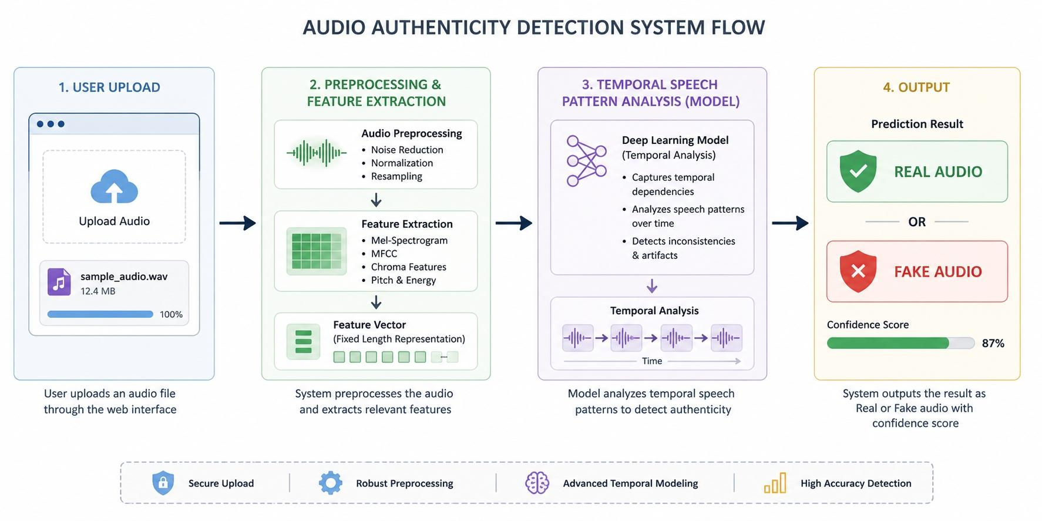

Slide 19
ARCHITECTURAL FRAMEWORK
Input audio file from user interface
Preprocessing and normalization stage
Feature extraction using embeddings
Model processing using LSTM/BiLSTM
Notes:
2

Slide 20
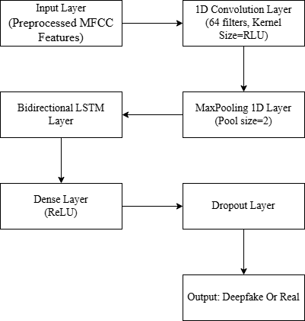
ARCHITECTURE DIAGRAM
Notes:
2

Slide 21
EXISTING SYSTEM
Uses spectrogram-based features with CNN models for detection.
Achieves comparatively lower accuracy (around 88%).
Requires high computational power and processing time.
Struggles to generalize on unseen or new deepfake audio samples.
Relies heavily on specific datasets, reducing real-world performance.
Notes:
2

Slide 22
PROPOSED SYSTEM
Uses advanced feature extraction (embeddings/MFCC) with a BiLSTM-based model.
Achieves higher accuracy (around 95%) compared to existing methods.
Provides better generalization to unseen deepfake audio samples.
More robust against variations in speech and recording conditions.
Ensures efficient and faster processing suitable for real-time detection.
Notes:
2

Slide 23
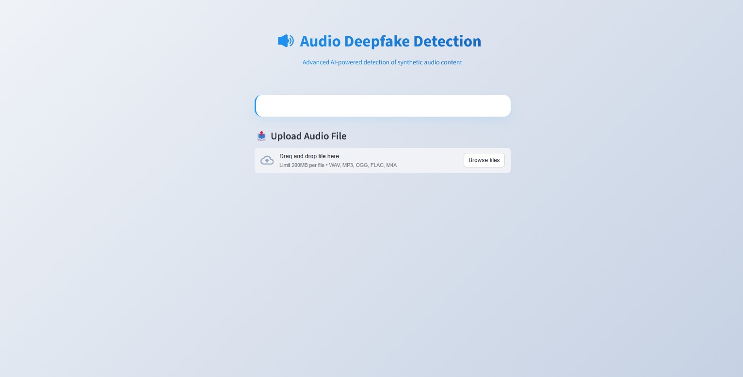
SCREENSHOT
Dashboard
Notes:
2

Slide 24
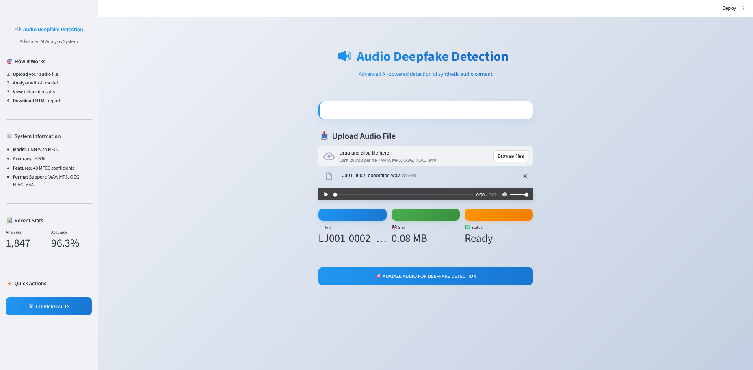
SCREENSHOT
Dashboard
Notes:
2

Slide 25
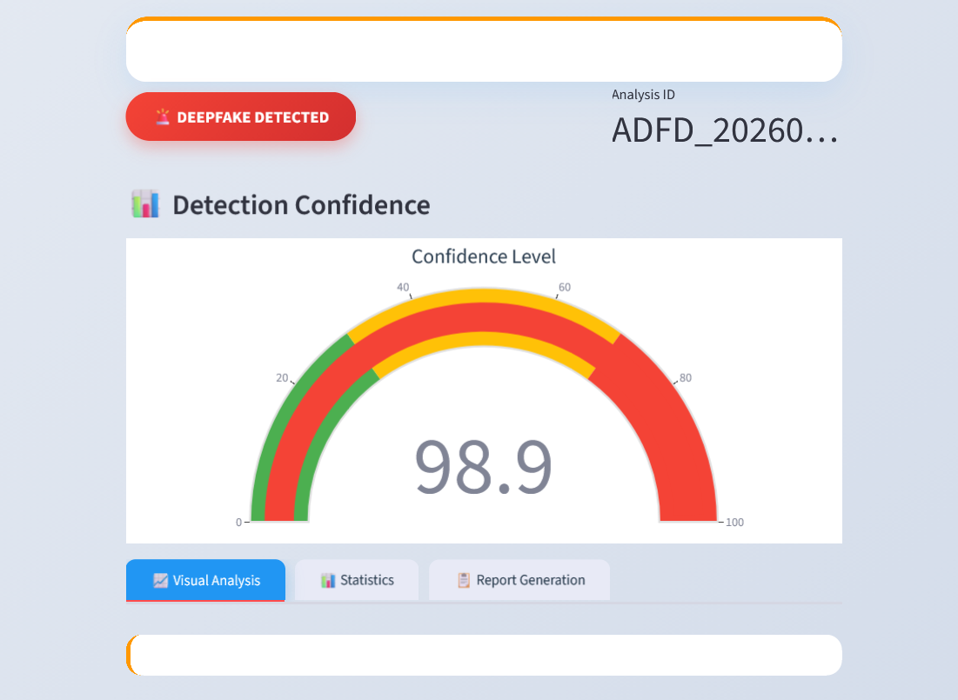
SCREENSHOT
Ai Audio
Notes:
2

Slide 26
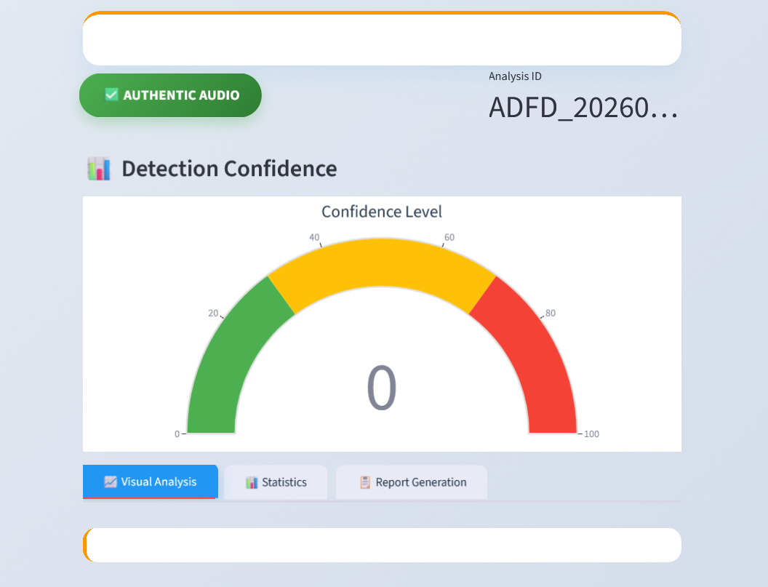
SCREENSHOT
Real Audio
Notes:
2

Slide 27
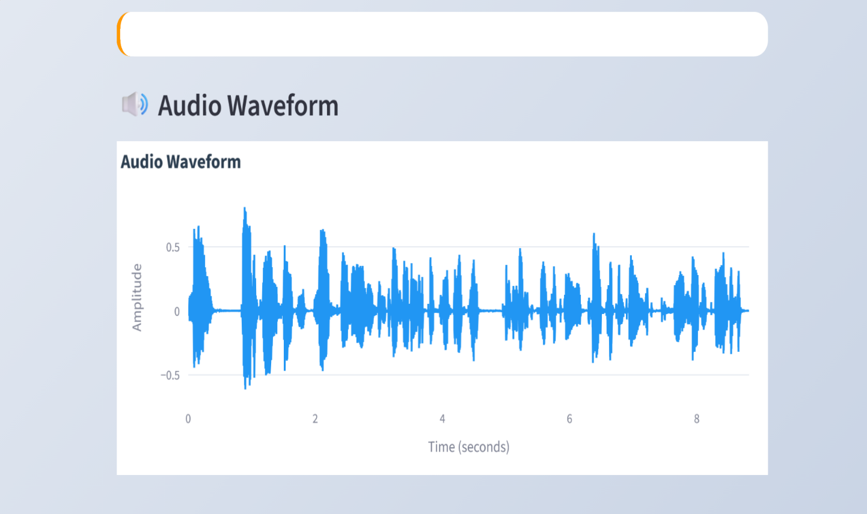
SCREENSHOT
Audio Waveform
Notes:
2

Slide 28
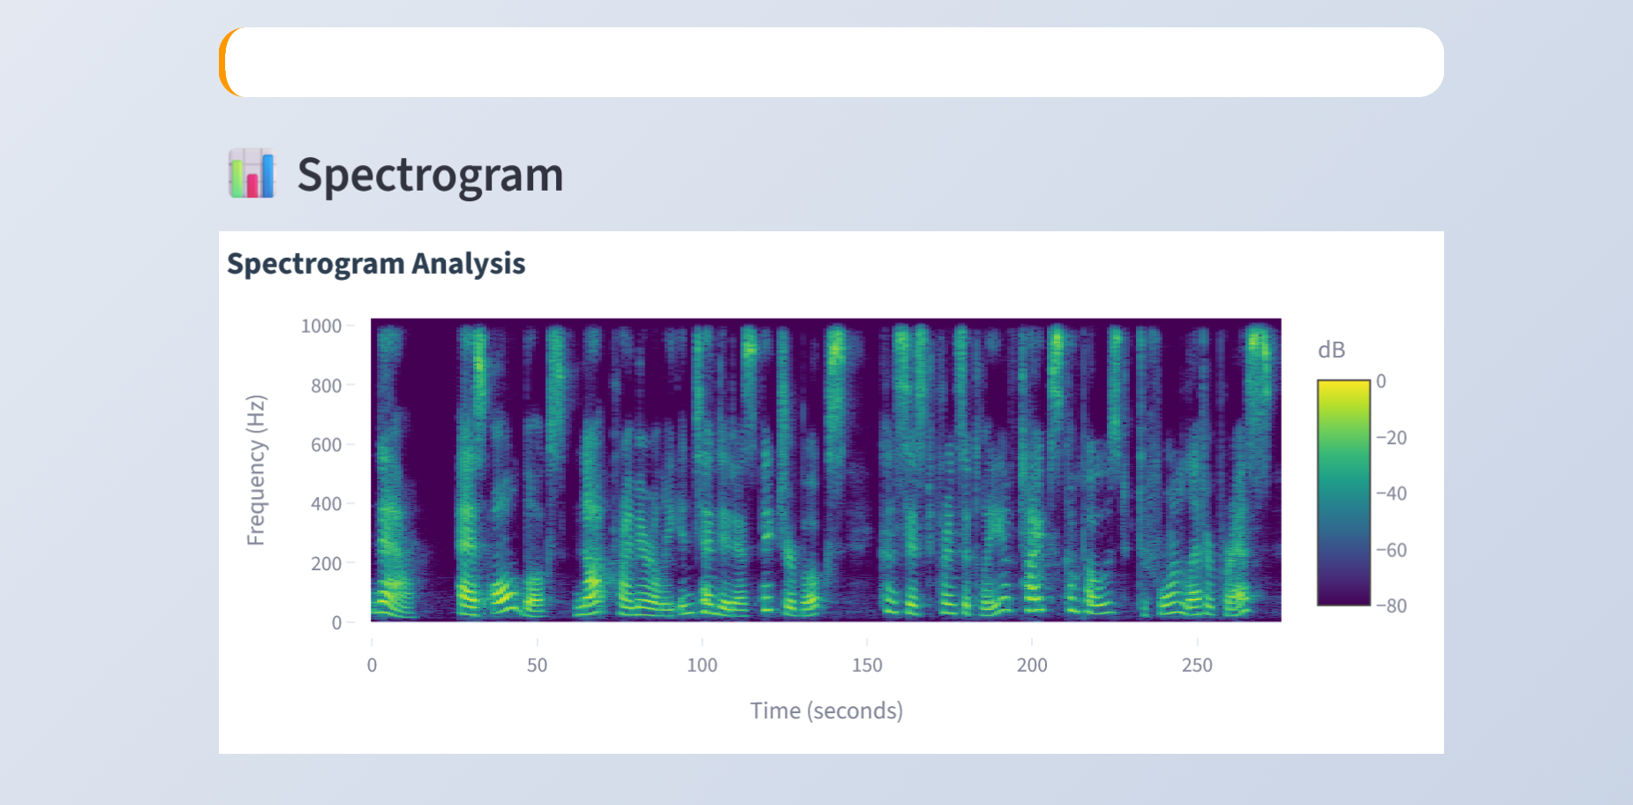
SCREENSHOT
Spectrogram Analysis
Notes:
2

Slide 29
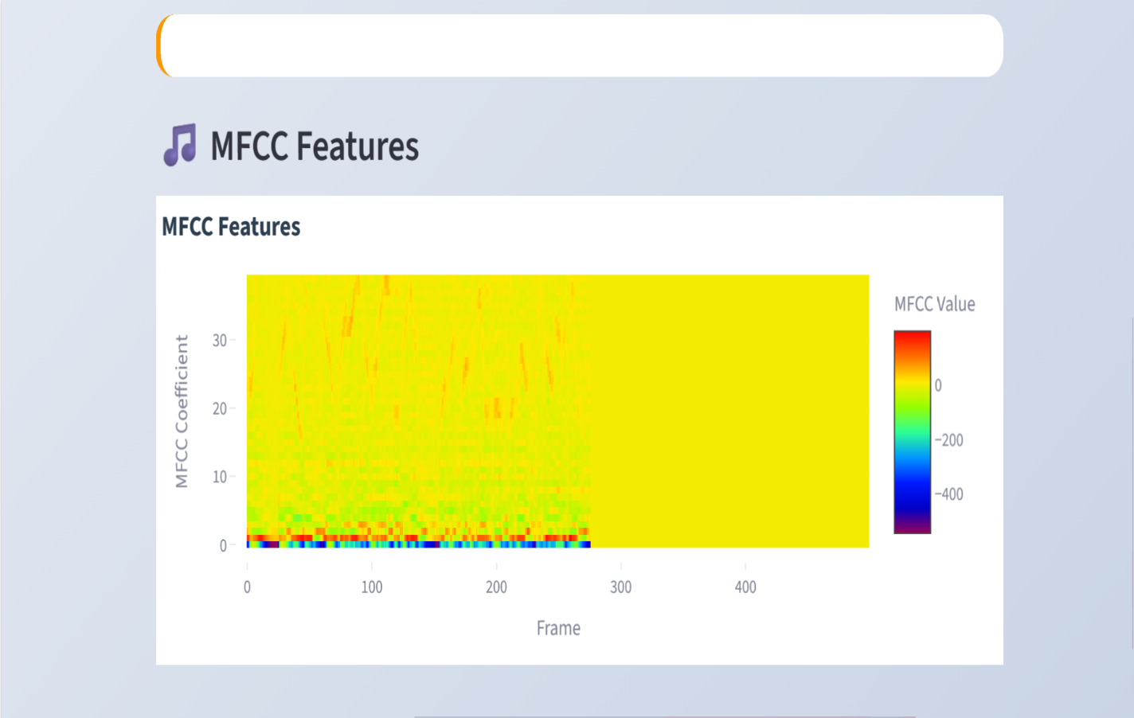
SCREENSHOT
MFCC Features
Notes:
2

Slide 30
ADVANTAGES
High accuracy in detecting deepfake audio.
Works efficiently in real-time applications.
Lightweight model with low computational cost.
Easy-to-use web-based interface for users.
Provides reliable and fast audio authenticity verification.
Notes:
2

Slide 31
APPLICATIONS
Cybersecurity and fraud prevention systems to detect voice-based scams.
Media verification and authentication to ensure content credibility.
Digital forensic investigations for analyzing manipulated audio evidence.
Voice-based authentication systems to prevent spoofing attacks.
Social media monitoring to identify and control misinformation.
Notes:
2

Slide 32
PUBLICATIONS
[1] M. Parvathi, A. Aravindhan, V. Madhan, R. Prem kumar
“Deepfake Audio Detection Using Self-Supervised Speech Embeddings and LSTM/BiLSTM Network”
presented at the Sixth International Conference on Artificial Intelligence and Smart Computing – 2026 (ICAISC 2026),Bannari Amman Institute of Technology Sathyamangalam, Tamil Nadu, India, Mar. 2026
Notes:
2

Slide 33
REFERENCE
Ritushree bohara and Amit kumar bairwa, "Detecting Deepfake Audio Using Spectrogram-Based MachineLearning Approaches", vol. 13, pp. 149478-149489, Aug. 2025
A. Hamza, A. R. Javed, F. Iqbal, N. Kryvinska, A. S. Almadhor, Z. Jalil, and R. Borghol, “Deepfake Audio Detection via MFCC Features Using Machine Learning,” IEEE Access, vol. 10, pp. 134018–134028, 2022
T. M. Wani, S. A. A. Qadri, D. Comminiello, and I. Amerini, “Detecting Audio Deepfakes: Integrating CNN and BiLSTM with Multi-Feature Concatenation,” in Proc. ACM Workshop on Information Hiding and Multimedia Security (IH&MMSec ’24), 2024, pp. 271–276.S.
Al-Halabi and A. Kafri, “Audio Deepfake Detection Using a Hybrid Model of Convolutional and Bidirectional Long Short-Term Memory Networks,” Adv. Appl. Sci., vol. 11, no. 1, pp. 1–7, Jan. 2026.
N. Babiker Mohammed Babiker, “Deepfake Audio Detection in Voice Authentication: A Spectral and CNN-Based Comprehensive Review,” Eng. Technol. Appl. Sci. Res., vol. 15, no. 6, pp. 29824–29832, Dec. 2025
Notes:
2

Slide 34
References
Baoping Liu, Bo Liu, Tianqing Zhu, Ming Ding, A Review of Deepfake and Its Detection: From Generative Adversarial Networks to Diffusion Models, International Journal of Intelligent Systems, 2025.
David Ghiurău, Daniela Elena Popescu, Distinguishing Reality from AI: Approaches for Detecting Synthetic Content, Computers (MDPI), 2025.
Sarah Tipper, Hany F. Atlam, Harjinder Singh Lallie, An Investigation into the Utilisation of CNN with LSTM for Video Deepfake Detection, Applied Sciences, 2024.
Achhardeep Kaur, Azadeh Noori Hoshyar, Vidya Saikrishna, Selena Firmin, Feng Xia, Deepfake Video Detection: Challenges and Opportunities, Artificial Intelligence Review, 2024.
Zekun Sun, Na Ruan, Jianhua Li, DDL: Effective and Comprehensible Interpretation Framework for Diverse Deepfake Detectors, IEEE Transactions on Information Forensics and Security, 2025.
Notes:
2

Slide 35
Demo Link
https://aravindhan002-deepfake-audio-detection-using-self----app-4urokb.streamlit.app/

Slide 36
Thank You

